Slide 1
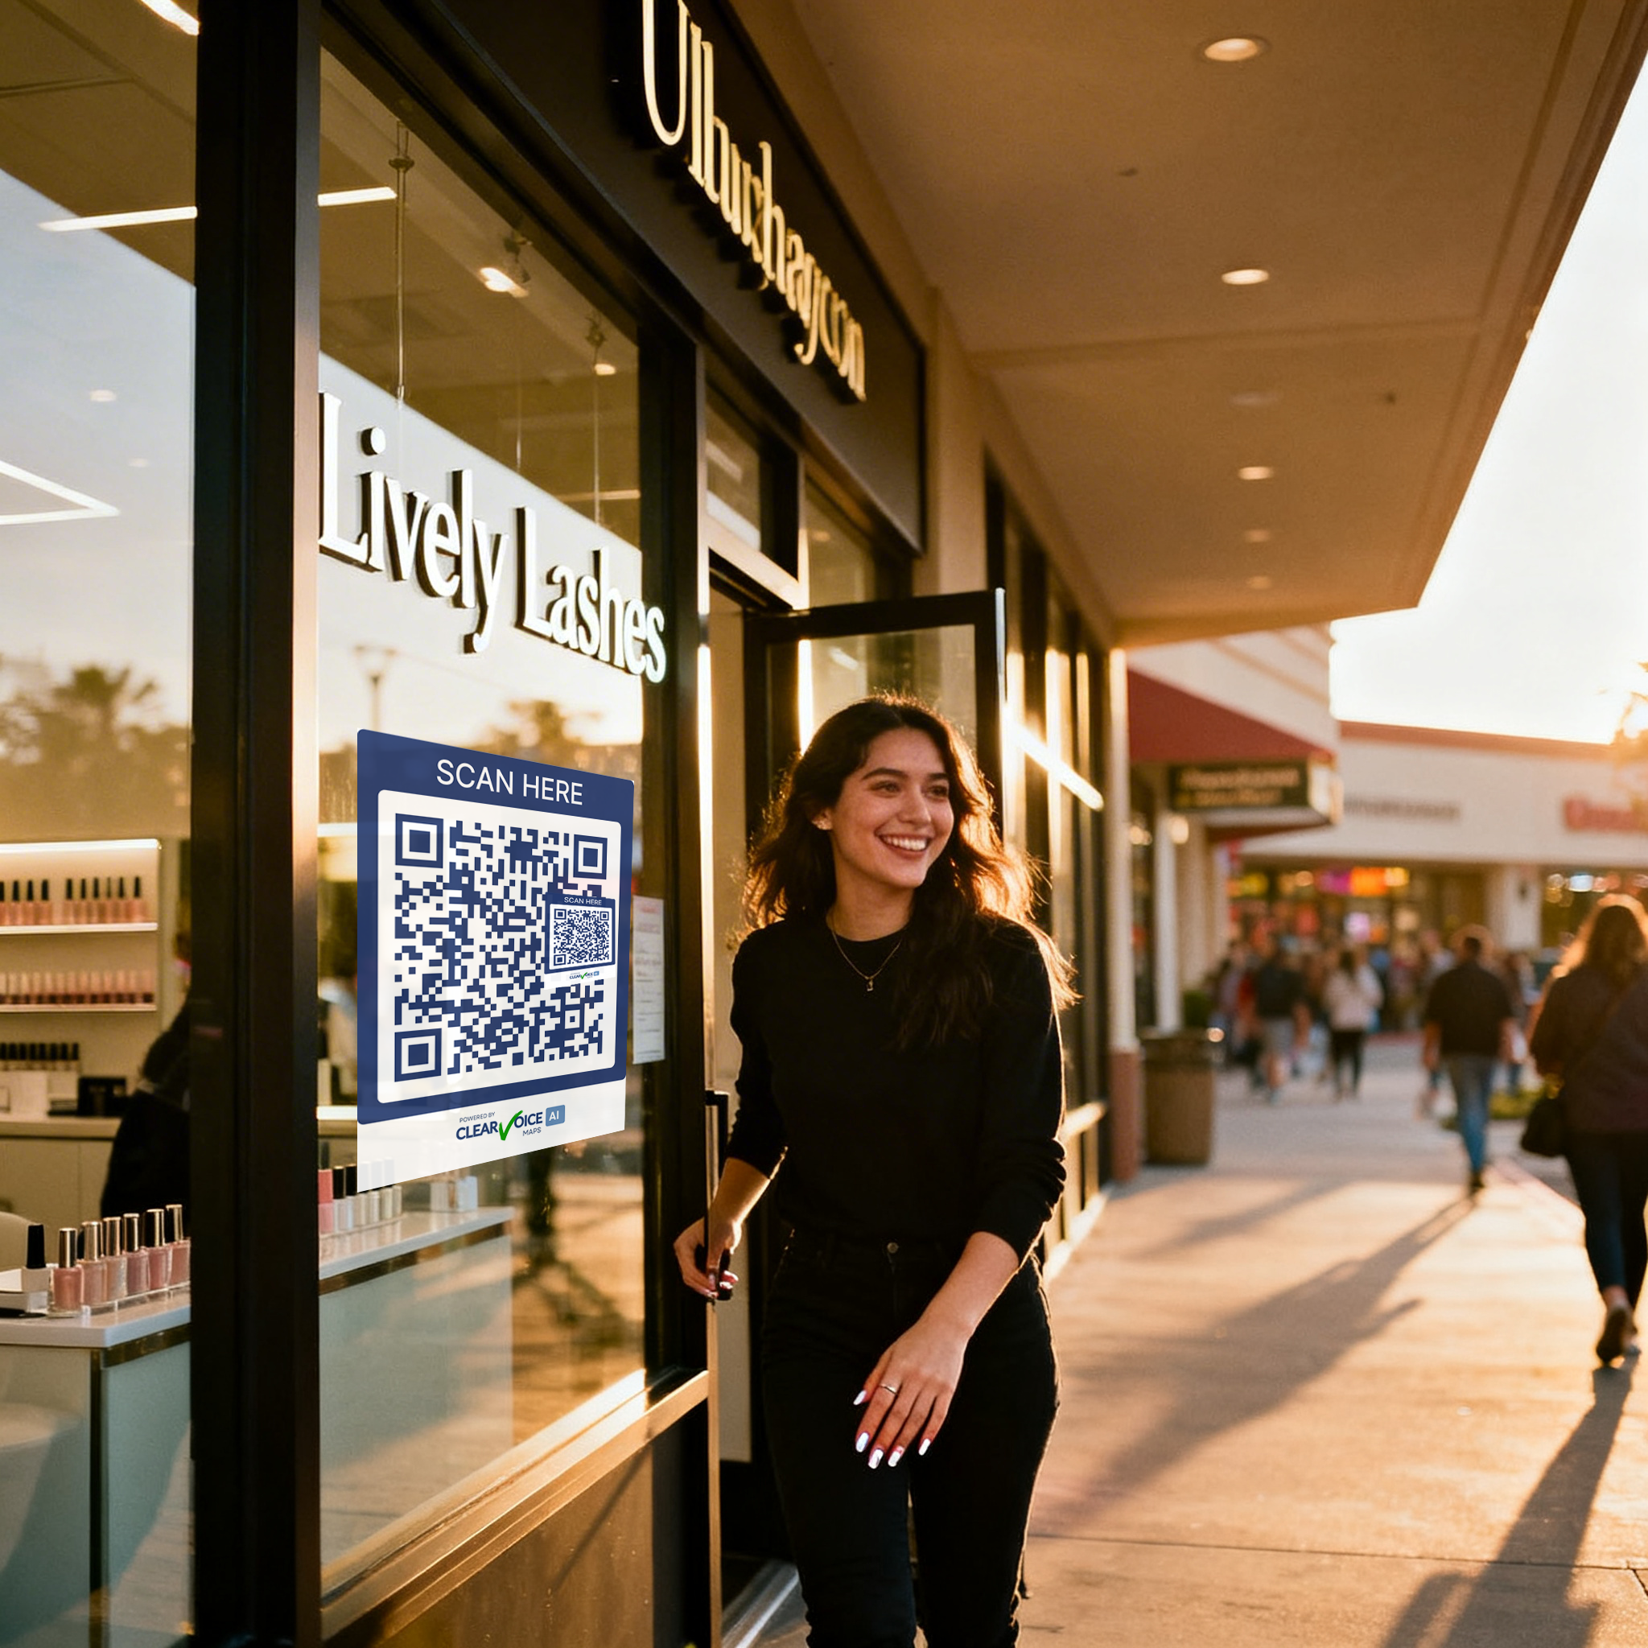
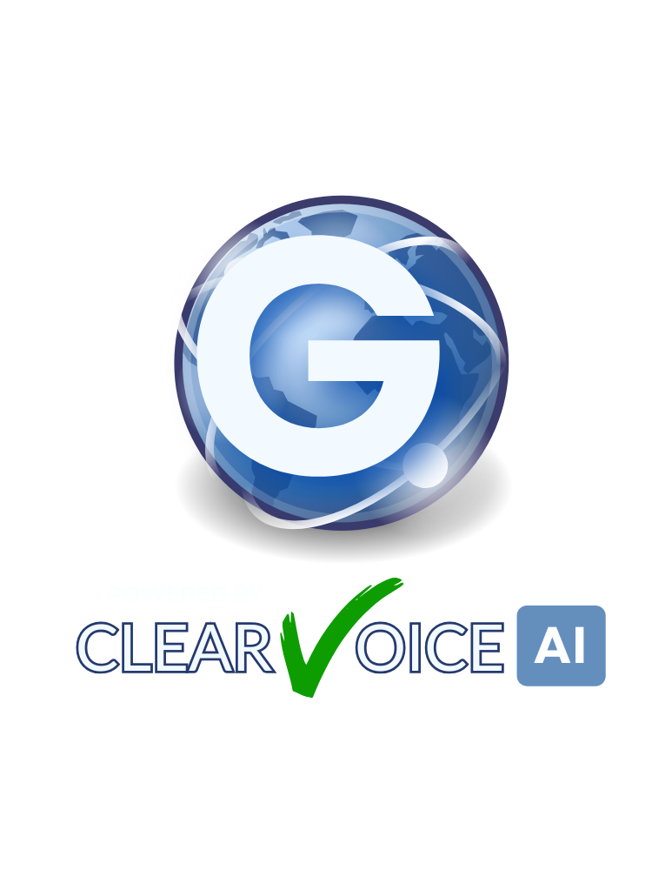
BUSINESS PLAN SUMMARY
Scan
Talk
Transact

Slide 2
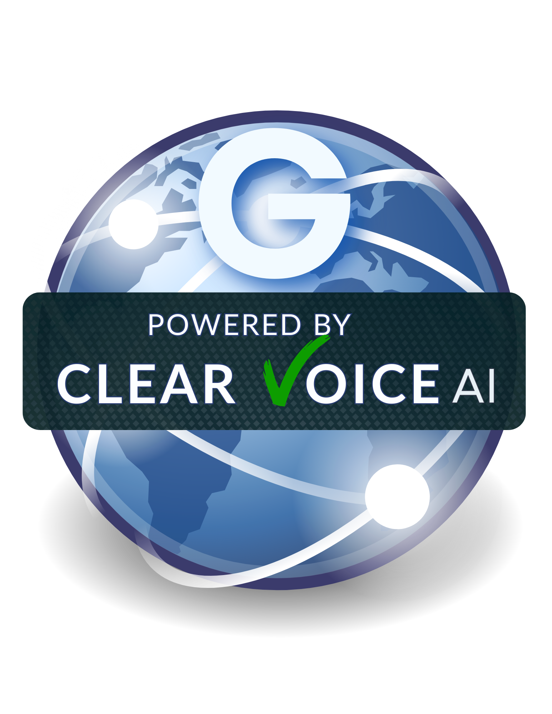
THE VISION
A New Way to Connect
Scan Any QR Code
Customers scan a QR code on any storefront and instantly open a web-based voice interface. No app installation required.
Talk to Business AI
The voice interface connects directly to an AI agent powered by verified business data and customer reviews.
Instant Transactions
Get answers, book appointments, and complete transactions—all through natural voice conversation.

Slide 3
THE PROBLEM
Traditional Communication is Broken
Phone systems are fundamentally incompatible with modern AI
Telephony Audio Issues
Cost & Experience
Narrowband codecs compress speech heavily, degrading AI transcription accuracy by up to 50%
Expensive infrastructure with per-minute carrier fees and toll charges
Phone trees & hold times frustrate customers and lose business
SIP trunk latency introduces delays and turn negotiation problems
Legacy complexity requires maintaining PBX systems and multiple vendors
Background noise from full-duplex calls ruins speech recognition
The Core Insight
Voice AI needs a different architecture—one that bypasses the entire traditional telecom stack. The solution isn't better phone systems; it's eliminating phone numbers entirely.

Slide 4
THE BREAKTHROUGH
What We Eliminate
QR-Based Voice AI Network
PSTN
The "Shadow Network" bypasses traditional telephony entirely
Public Switched Telephone Network
SIP Trunks
How It Works
Session Initiation Protocol
Call Negotiation
Customer scans QR code
Complex routing & handshakes
On storefront, menu, or product display
Phone Numbers
Traditional numbering system
Web voice interface opens
No app download—runs in browser
Direct AI connection
WebSocket/WebRTC to AI agent
What Remains
Just pure IP voice—direct, high-fidelity, low-latency communication between customer and AI.

Slide 5
TECHNICAL ADVANTAGE
Voice AI Performs Better Over IP
Dramatic improvements in quality, speed, and reliability
Higher Audio Fidelity
Lower Latency
Better Recognition
Wideband codecs (16-48kHz) vs. narrowband telephony (8kHz). Crystal-clear audio that AI can understand.
Direct WebRTC connection eliminates routing delays. Sub-300ms response times vs. 1-2+ seconds on PSTN.
Higher transcription accuracy with uncompressed audio. AI understands intent more reliably.
Push-to-Talk Innovation
Faster Response Time
Our push-to-talk model eliminates background noise by only transmitting when the user holds the button. This solves the turn-taking problem that plagues full-duplex phone calls.
Without SIP negotiation and carrier routing, responses are near-instantaneous. Customers get answers in seconds, not minutes.
Under 1 second end-to-end
90% fewer voice tokens wasted on silence
Result:Voice AI becomes fast, reliable, and dramatically cheaper—orders of magnitude less expensive than traditional telephony.

Slide 6
THE PRODUCT
Example Customer Queries
AI Maps for Business
Instant AI assistant deployment for any business
"Do you have appointments today?"
→ AI checks real-time availability and offers time slots
Customer Interaction Flow
"What services do you offer?"
1. Scan QR Code
→ AI lists services with descriptions and pricing
Customer points phone at storefront sticker
2. Ask Questions
"How much is a gel manicure?"
Natural voice conversation with AI
→ AI provides current pricing and package options
3. AI Answers Instantly
"Can I book?"
Using verified business data & reviews
→ AI completes booking and sends confirmation
The AI only uses verified business data and reviews—no hallucinations, no generic responses.

Slide 7
MARKET READINESS
QR Adoption is Massive
Consumers already scan QR codes for everything—now they'll scan to talk
90%
100%
0
Scan Regularly
Native Support
Apps Required
of consumers scan QR codes at least once per week
of smartphones support QR scanning out of the box
no downloads, no installation, no friction
What Consumers Already Scan For
Menus
Payments
Check-ins
Promotions
Restaurant ordering
Contactless checkout
Events & travel
Discounts & deals
Now they scan to talk to businesses

Slide 8
PLATFORM DYNAMICS
The Growth Flywheel
The Network Effect
Two-sided platform with powerful flywheel
More Businesses Join
Salons, restaurants, retail stores deploy QR stickers
Platform Sides
More Customer Scans
Higher visibility leads to increased usage
Side 1: Businesses
Deploy QR voice assistants on storefronts, menus, and products. Get 24/7 AI receptionist.
More Voice Data
Rich training data improves AI responses
Side 2: Customers
Better AI Performance
Use voice AI to interact with businesses—instant answers, bookings, and transactions.
Superior experience attracts more businesses
This creates defensibility and scale—the classic network effect that builds platform moats.

Slide 9
MARKET OPPORTUNITY
Target Market
Small businesses with walk-in customers—starting with the salon industry
Nail Salons
Hair Salons
Restaurants
Spas
Hotels
Retail Stores
Medical Offices
And More
Global Salon Market
Why Salons Are Perfect
$265B → $523B
High call volume for appointments and inquiries
The salon industry alone represents a massive opportunity, projected to nearly double by 2034. This is just one vertical of many.
Repetitive questions about services and pricing
Walk-in customers who can scan QR codes
Perfect for AI automation with structured data

Slide 10
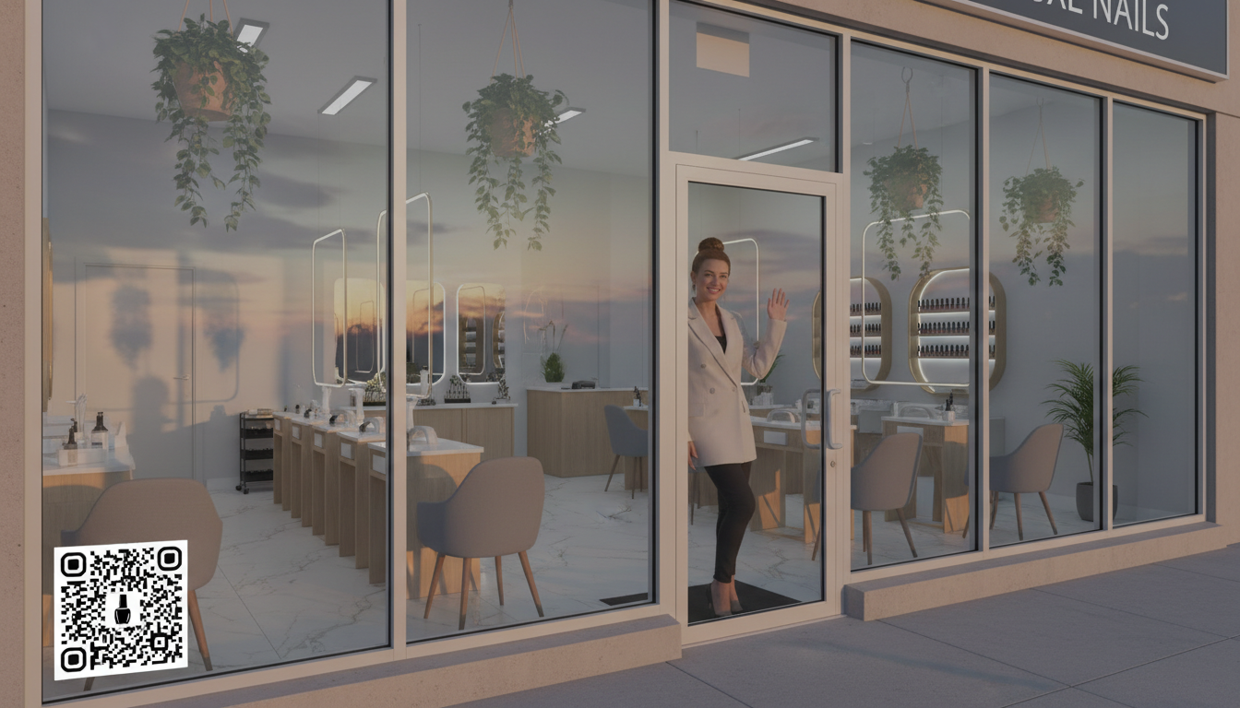
PILOT PROGRAM
Nail Salon Pilot
Las Vegas test vertical—proving the model
Pipeline Process
What Salons Get
1
Find Businesses
Instant AI Receptionist
Identify salons via Google Places API
24/7 voice assistant answers calls, books appointments, and handles inquiries
2
Pull Reviews
Extract customer feedback and insights
3
Analyze with AI
Competitor Insights
Generate industry insights and patterns
AI analyzes reviews from competitors to identify market opportunities
4
Deploy AI Assistant
Launch voice AI with business data
Automated Responses
Smart replies to common questions about services, pricing, and availability
Location:Las Vegas — High-density salon market with tech-forward businesses and tourists familiar with QR codes

Slide 11
PRODUCT FEATURES
Storefront Experience
Live AI profile page—one interface for all customer interactions
AI Profile Features
Customer Actions
AI Assistant Chat
Text-based conversation with business AI
Voice Interaction
Call
Text
Push-to-talk voice conversations
Direct phone connection
SMS messaging
Google Maps Data
Location, hours, and directions
Review Intelligence
Aggregated customer feedback insights
Website
Email
Visit online
Send message
All from one unified interface
The Goal: Unified Customer Experience
Customers get a single, consistent interface for interacting with any business—whether they want to talk to AI, call directly, send a text, or visit the website. One QR code, infinite possibilities.

Slide 12
ONBOARDING
Three Simple Steps
Find Your Business
1
Businesses onboard in minutes, not days
Search for your business on Google Maps. Our system pulls existing data including location, hours, photos, and reviews.
Google Maps integration
2
Design Your QR Code
Customize colors and branding to match your business. Preview how the QR sticker will look on your storefront.
Brand customization
Then AI Goes Live
Once verified, the AI assistant is immediately active and ready to handle customer inquiries 24/7.
Verify Customer Routes
3
Set how customers can reach you: phone, text, email, website. The AI uses these to complete transactions.
Call
Text
Email
Web

Slide 13
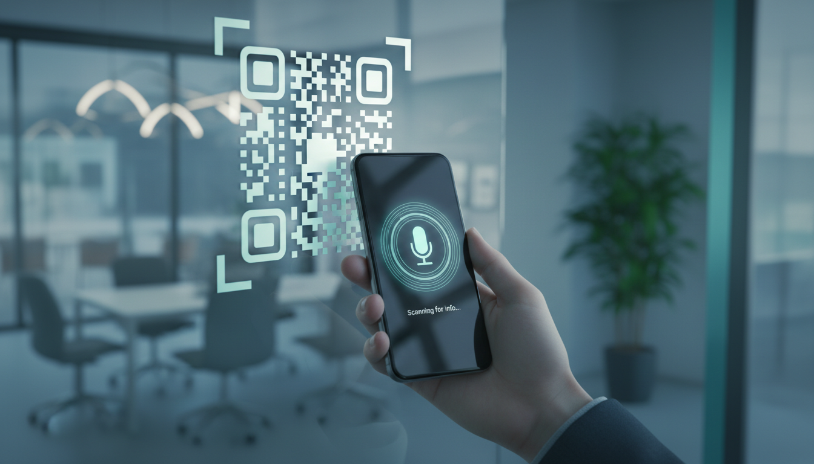
PHYSICAL DEPLOYMENT
The QR Sticker
Storefront AI portal—turning physical locations into voice endpoints
Placement Locations
Historical Parallels
Windows
Apple Pay
Front-facing visibility
Changed payments forever by making contactless transactions effortless. QR voice will do the same for business communication.
Front Desks
Reception areas
Menus
QR Menus
Table-top placement
Replaced paper menus during COVID and became permanent. Customers now expect to scan for information—voice is the natural next step.
Tables
Dining surfaces
Customers scan and immediately talk to business AI
Product Displays
Retail shelving

Slide 14
BUSINESS MODEL
Revenue Model
Multiple streams for sustainable growth
Basic
Professional
Advanced
$29
$79
$199
/month
/month
/month
AI voice assistant
Everything in Basic
Everything in Pro
Basic analytics
Advanced analytics
CRM integration
1 QR sticker
Booking integration
Priority support
Add-Ons
Marketplace
Advanced Analytics
+$29/mo
Businesses can pay to be promoted in AI Maps search results when customers search for services in their area.
Booking Integration
+$49/mo
Featured Listings
CRM Integration
+$79/mo
Pay-per-click or subscription
Advertising
Varies

Slide 15
STRATEGIC POSITIONING
What This Means
Why This Is Big
Internet-Native
Not just a chatbot—a new communication layer
Businesses become discoverable and interactable via web protocols, not legacy telecom.
The Shift
Voice-First
Natural conversation replaces navigating phone trees and waiting on hold.
Old Model
AI-Powered
Businesses identified by phone numbers—legacy infrastructure, expensive, poor AI performance.
Every business gets a 24/7 intelligent assistant that learns and improves.
Networked
Each new business strengthens the platform for all—classic network effects.
New Model
Businesses become voice endpoints on the internet—direct IP connection, cheap, AI-optimized.
Every storefront becomes an AI interface

Slide 16
TECHNICAL MOAT
Technology Advantage
Key architectural decisions that create defensibility
1
Single Model Architecture
Using Gemini 2.5 as our unified AI engine instead of juggling multiple specialized models. This eliminates compatibility issues, reduces latency, and ensures consistent performance.
No model conflicts
Lower latency
Consistent quality
2
IP Voice Architecture
Bypassing the entire telephony stack—no PSTN, no SIP, no carriers. Direct WebRTC connection from customer phone to AI server delivers superior audio quality at a fraction of the cost.
Higher fidelity
Lower cost
Better AI accuracy
3
Locked Agent Design
Pre-configured AI agents with controlled customization. Businesses can't accidentally break the AI with rogue edits or no-code corruption. The system stays stable and predictable.
No corruption
Consistent experience
Easy maintenance

Slide 17

GROWTH STRATEGY
Distribution Strategy
QR sticker affiliate program for rapid expansion
The Affiliate Model
Example: City Affiliate
Partners Distribute QR Kits
100
100
100
Local affiliates receive QR sticker kits and onboarding materials to distribute to businesses in their area.
Salons
Restaurants
Retail Stores
Earn Commission
Total Businesses
300
Affiliates earn 14% of monthly subscriptions from businesses they sign up—recurring revenue.
Avg. Subscription
$50/mo
Monthly Revenue
$15,000
Rapid Geographic Expansion
Each sticker deploys AI instantly. Scale city by city without heavy infrastructure.
$2,100/mo
Affiliate Commission (14%)
The fastest growth channel:grassroots distribution powered by local entrepreneurs

Slide 18

LONG TERM VISION
AI Maps
A global network of AI-enabled businesses
Global Network
Voice-First Interaction
Operating System
Every storefront with a QR AI assistant, creating a worldwide mesh of voice-enabled businesses
Customers interact with businesses through voice AI instead of phone calls—faster, better, cheaper
The infrastructure layer for local commerce—discovery, interaction, and transaction in one platform
If every storefront has a QR AI assistant... this becomes the operating system for local commerce

Slide 19
MARKET TIMING
Why Now
Voice AI Is Finally Good Enough
Three technologies just converged
Large language models like Gemini 2.5 have achieved human-level conversation quality. Speech recognition accuracy exceeds 95% for most use cases. The technology is ready for prime time.
QR Scanning Is Universal
90% of consumers scan QR codes weekly. Post-COVID behavior change made QR scanning second nature. Every smartphone has native support—no apps needed.
This Moment Creates a New Category
The convergence of mature voice AI, universal QR adoption, and reliable web voice streaming creates a unique window of opportunity that didn't exist before.
Web Voice Streaming Is Reliable
WebRTC has matured with sub-300ms latency and robust echo cancellation. 5G and improved mobile data make IP voice viable everywhere. The infrastructure is ready.

Slide 20
MARKET SIZE
The Opportunity
Massive market potential—millions of businesses worldwide
~1M
~700K
33M+
Beauty Businesses
Restaurants
Small Businesses
in the United States alone
across the United States
total in the United States
Just the U.S. Market
Revenue Potential
Beauty & Personal Care
~1M
If we capture just 1% of U.S. small businesses:
Customers
~330K
Restaurants & Food Service
~700K
Retail Stores
Millions
At average $50/month subscription:
Monthly Revenue
$16.5M
Hotels & Hospitality
~100K+
Annual Revenue
$198M
This becomes a $100M+ platform business—and that's just the beginning

Slide 21
THE ASK
What We Need
Launch the First AI Storefront Network
Seed Funding
To build team, develop product, and launch pilot
Strategic Partners
Goal
Salon industry connections, local business networks
Early Adopters
Immediate Focus
Businesses willing to pilot the technology
Nail salon pilot program
Las Vegas market launch
QR distribution program
From There
The Opportunity
Scale city by city using the affiliate distribution model. Expand to new verticals. Build the AI Maps network.
$100M+
Platform potential
Possibly much bigger

Slide 22
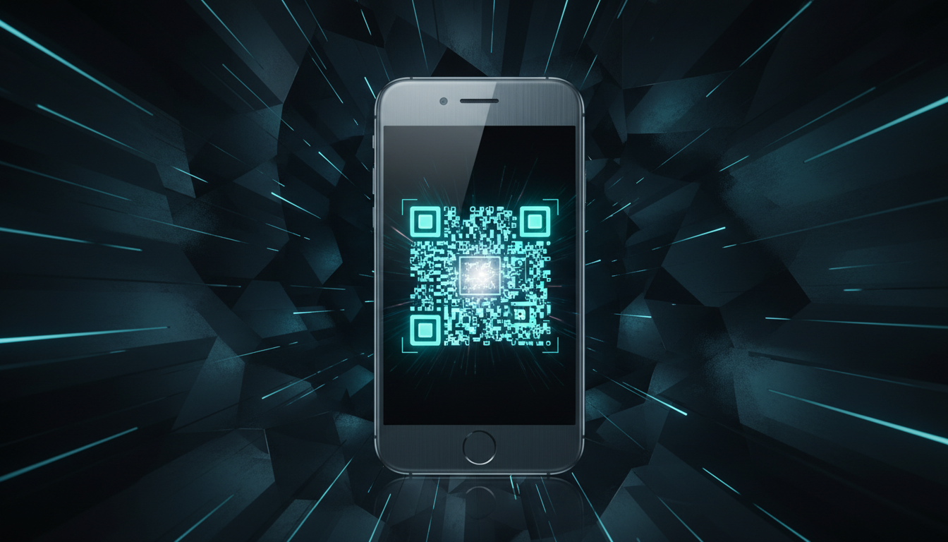
Clear Voice AI
AI Maps for Business
The future of local business communication
Scan
→
Talk
→
Done
Every storefront becomes an AI interface.
No phone numbers. No apps. No downloads.
Just scan → talk → transact.

